Slide 1
Title: Amazon Product Review Sentiments Presentation Subtitle: Using Deep Learning and NLP Techniques Name: Hassan Sattar Roll no: 22F-3773

Slide 2
Agenda
2
Introduction
Problem Setup
Data Overview
Tools and Libraries Used
Data Preprocessing
Model Architecture
Training the Model
Predictions and Examples
Flask App
Deploy Cloud Server

Slide 3
Introduction
3
This machine learning project focused on performing sentiment analysis on Amazon product reviews. The aim is to classify the sentiments expressed in the reviews as either positive or negative. This can assist businesses in automating the analysis of customer feedback and enhance user experience through improved product recommendations.
Objective: To analyze customer sentiments from Amazon product reviews using advanced neural network models.
Importance of Sentiment Analysis: how sentiment analysis helps businesses understand customer opinions and improve products and services.
Purpose: Engage the audience by highlighting the relevance of sentiment analysis in real-world applications.

Slide 4
Problem Setup
4
Sentiment analysis project based on the Amazon reviews dataset, the problem setup can be defined as a binary classification task where the goal is to determine the sentiment expressed in the text of a product review.
Problem Setup:
Objective: To automatically classify the sentiment of text-based product reviews.
Input: The input to the model is the text of a product review.
Output: The output is a sentiment classification, which can either be "Positive" or "Negative"

Slide 5
Data Overview
5
Data Source: The data is sourced from Kaggle's Amazon Reviews dataset. (https://www.kaggle.com/datasets/bittlingmayer/amazonreviews)
Data Content: The types of data included text reviews with labels.
Purpose: This dataset consists of a few million Amazon customer reviews (input text) and star ratings (output labels) for learning how to train fastText for sentiment analysis

Slide 6
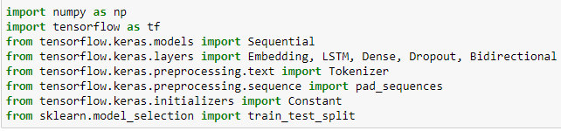
Tools and Libraries Used
6
List of Tools: Python, TensorFlow, Keras.
Libraries: we used NumPy for numerical operations, TensorFlow for building and training models, and GloVe embeddings for numerical index vecterization.
Download the Glove Embedding from Kaggle here (https://www.kaggle.com/datasets/danielwillgeorge/glove6b100dtxt)
Purpose: It show the technical foundation of that project.

Slide 7
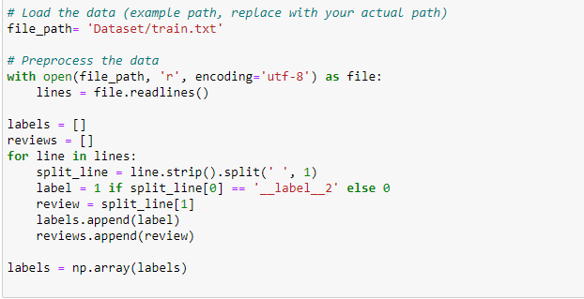
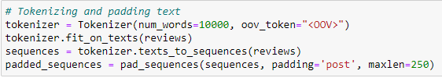
Data Preprocessing
7
Reading Data: This process of loading the data from the file.
Cleaning and Tokenizing: Text cleaning and the tokenization process.
Sequence Padding: padding is necessary to create uniform input sizes for neural network processing.
Purpose: Raw data is transformed into a format suitable for model training.

Slide 8
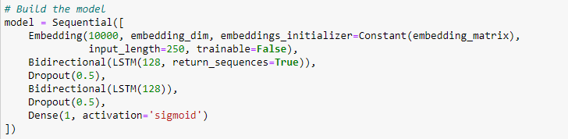
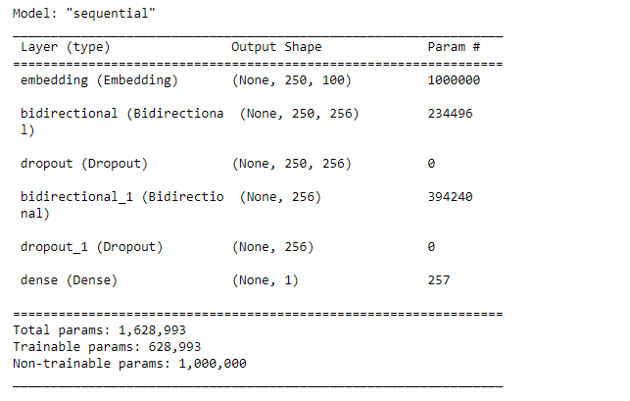
Model Architecture
8
Sequential Model: Introduce the architecture starting with the input layer.
Layers Explained: Describe each layer (Embedding, LSTM, Dense, Dropout) .
GloVe Embeddings: The role of GloVe embeddings in enhancing model understanding of text semantics.
Purpose: IT provide a technical overview of the model’s structure

Slide 9
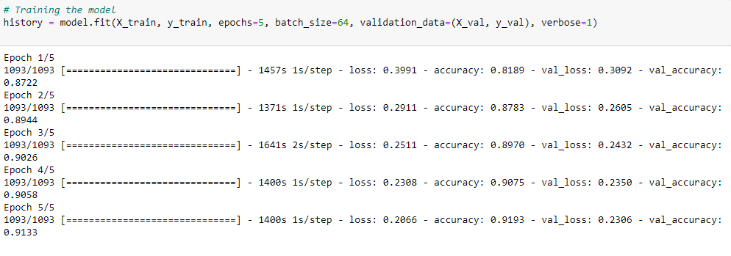
Training the Model
9
Data Splitting: The data is divided into training and validation sets.
Training Parameters: Specify the number of epochs, batch size, and any other relevant parameters.
Purpose: The model is trained and tuned.

Slide 10
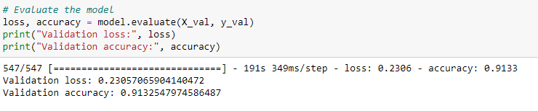
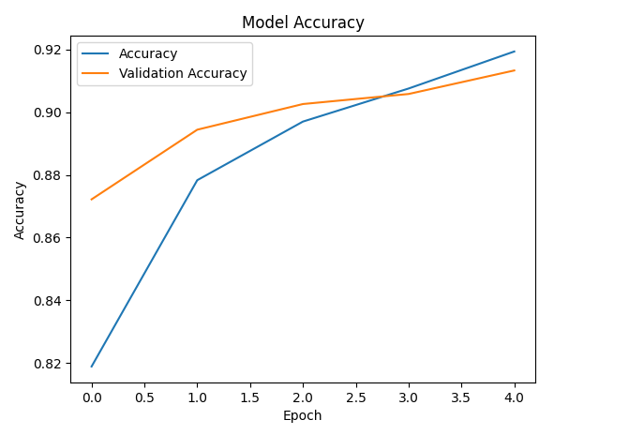
Model Evaluation
10
Evaluation Metrics: Define the metrics used such as accuracy and loss.
Performance Overview: Share results from the model performance on validation data.
Purpose: Assess the effectiveness of the trained model.

Slide 11
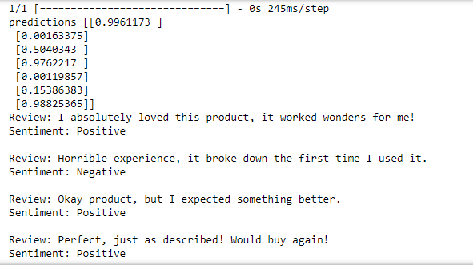
Predictions and Examples
11
Predictions: Show examples of text reviews and their predicted sentiments.
Visuals: Consider including screenshots or snippets of the output predictions.
Purpose: Demonstrate the practical application and accuracy of the model.

Slide 12
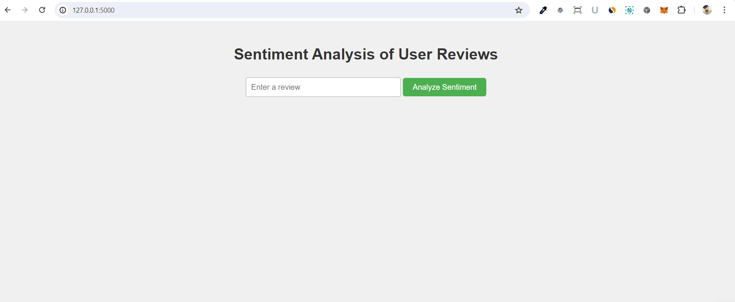
Flask App
12
Purpose: The Flask application in sentiment analysis.
Functionality: It analyzes user-submitted reviews in real-time and predicts sentiment as positive or negative.
User Interaction: users interact with the application through a web interface.

Slide 13
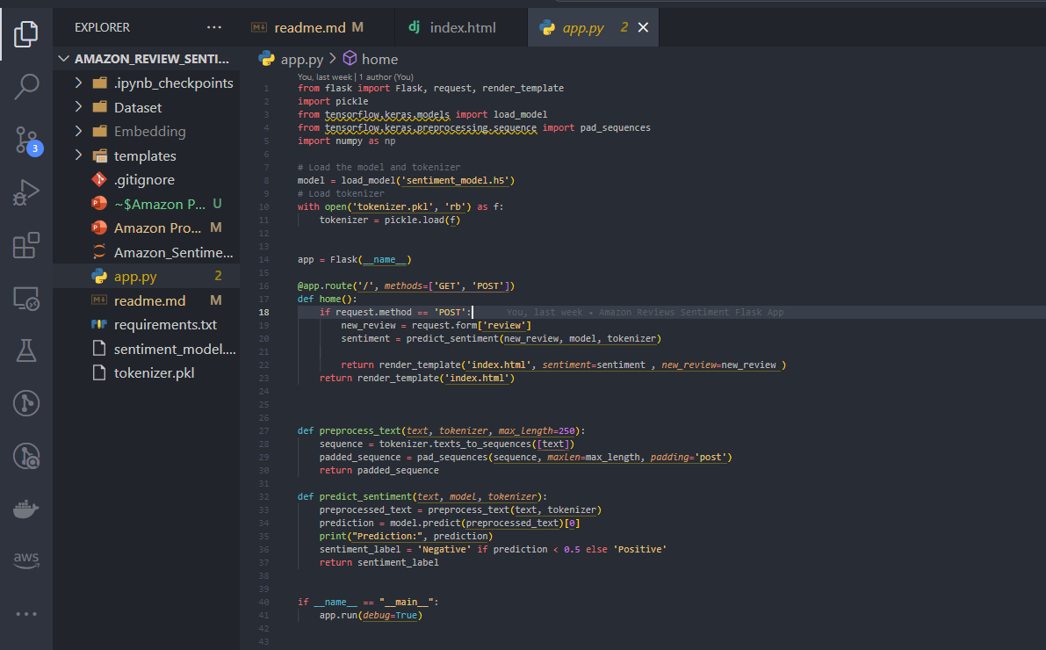
Flask App
13
Technologies Used:
Flask for the web framework.
TensorFlow/Keras for handling the machine learning model.
Pickle for loading pre-processed data.
Frontend: HTML/CSS for the web interface design.

Slide 14
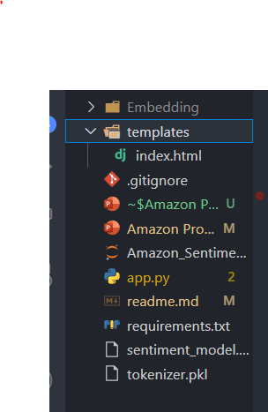
Flask App
14
Flask Application Structure
Key Components:
app.py: Contains routes and model loading logic.
sentiment_model.h5: The pre-trained machine learning model.
tokenizer.pkl: Used for text preprocessing.
HTML templates for the user interface.

Slide 15
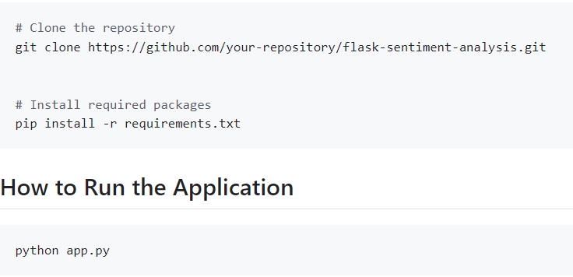
Flask App
15
Installation Steps:
Clone the repository and install dependencies.
Specific commands for setting up the environment and dependencies.
Running the Application: Guide to launching the Flask app locally. Navigate to http://127.0.0.1:5000/ in your web browser to use the application.

Slide 16
Cloud Server
16
Deploying Flask Application on AWS EC2
Overview of Deployment:
Explanation of choosing Amazon EC2.
Steps to create an EC2 instance and setup.
Security: Setting up security groups for SSH and HTTP/HTTPS access.

Slide 17
Cloud Server
17
Detailed EC2 Setup
Steps:
Launching the instance with the appropriate AMI and instance type.
Configuring network settings and security rules.
Installing Python and virtual environment setup

Slide 18
Cloud Server
18
Installing and Running Flask on EC2
Commands and Configuration:
Installation of Flask and other necessary packages.
Steps to run the Flask application using Gunicorn.
Systemd and Nginx Configuration:
Setting up Gunicorn with systemd for automatic restarts.
Configuring Nginx as a reverse proxy to route requests.

Slide 19
Cloud Server
19
Accessing and Testing the Flask Application
How to Access:
Using the public IP address to interact with the Flask application through a web browser.
Testing Functionality: Demonstrating a live example of submitting a review and receiving sentiment analysis.

Slide 20
Thank You
Q&A
hasansattar650@gmail.com

